Slide 1
Deep learning for natural dialogue modelling
Milica Gašić
Dialogue Group, Heinrich Heine University Düsseldorf

Slide 2
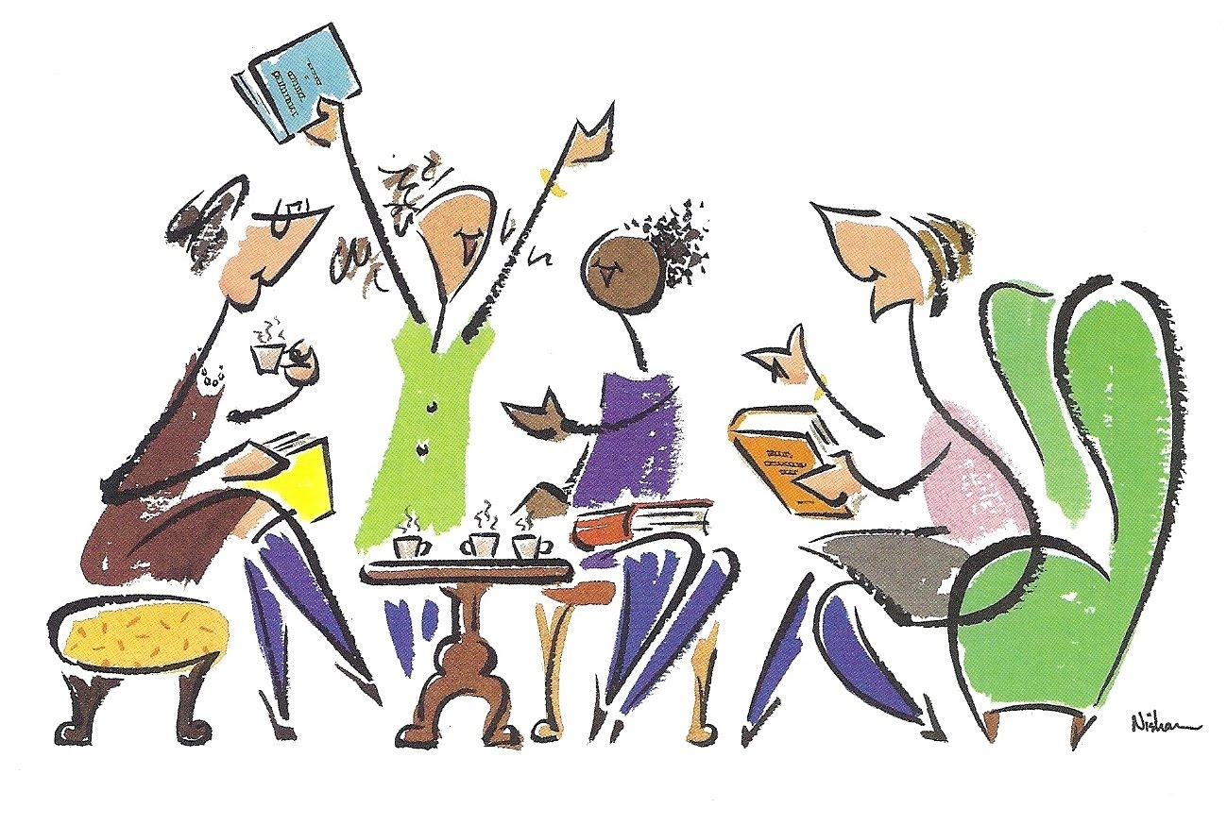


Research question
Current dialogue models are unnatural, narrow in domain and frustrating for users.
How do we build a continuously evolving dialogue model capable of natural conversation?

Slide 3

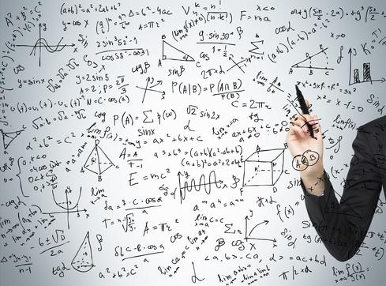

Machine learning for dialogue modeling
Notes:
It is very attractive to use machine learning for dialogue

Slide 4
Statistical dialogue modelling

Slide 5
Statistical dialogue modelling

Slide 6
Problems
Models that keep track of context do not scale
Models that learn how to respond choose between small set of actions
Systems are agnostic to different user needs

Slide 7
No belief tracking
Notes:
THAI is similar to HI

Slide 8
Belief tracking
Notes:
New probability is much higher
The new action is much better than the one taken before

Slide 9
Problem: Scaling up belief tracking
Problem:
If we treat every concept separately we need training data for every concept. Does not scale!!
Solution:
Reuse knowledge for different concepts
Essential ingredients
Semantically-constrained word vectors
Architecture that shares parameters

Slide 10
Semantically-constrained word vectors
Mrkšić, Ó Séaghdha, Thomson, Gašić, Rojas-Barahona, Su, Vandyke, Wen and Young. Counter-fitting Word Vectors to Linguistic Constraints. NAACL, 2016
Notes:
Concepts: domain, slots, values
We can represent these as distributed vector representations
We can induce semantic information via counter-fitting

Slide 11
Multi-domain belief tracking with knowledge sharing
Notes:
What do we have in the ontology?
What does the user refer to?
What does the system refer to?
How do we keep track of context?

Slide 12
Data sets
Datasets are collected in a Wizard of Oz setting
 | WOZ 2.0 | MultiWOZ
# of dialogues | 1200 | 9855
# of domains | 1 | 5
Avg. # of turns | 7.45 | 14.30
# of slots | 7 | 27
# of values | 99 | 663

Slide 13
Results
Accuracy
 | NBT | NBT-KS | NBT | NBT-KS
Food | 88.9 | 96.4 | 78.3 | 85.3
Price | 93.7 | 97.6 | 92.6 | 93.6
Area | 94.3 | 98.1 | 78.3 | 86.4
WOZ 2.0
MultiWOZ (restaurants)
 | Uniform | NBT-KS
Average Accuracy | 10.8 | 93.2
MultiWOZ
Ramadan, Budzianowski, Gašić, Large-Scale Multi-Domain Belief Tracking with Knowledge Sharing, ACL, 2018

Slide 14
Belief tracking vs policy optimisation

Slide 15
Reinforcement learning
observations o_{t}
Dialogue system
reward r_{t}
belief states b_{t}
action a_{t}
Notes:
- Example of rewards

Slide 16
Reinforcement learning
observations o_{t}
Dialogue system
reward r_{t}
belief states b_{t}
action a_{t}
Long term user satisfaction
Policy
Notes:
Explain that Q is long term user satisfaction

Slide 17
Reinforcement learning
Return
Value function
Q-function

Slide 18
Deep Reinforcement Learning
Value function, Q-function or policy approximated via a neural network
(+) approximation by non-linear functions
(as preferred in reinforcement learning)
(-) optimisation algorithms find only local optima.

Slide 19
Deep Q-network (DQN) algorithm
Q-function is approximated as a deep neural network, the gradient is
(-) a biased estimate
(-) states are correlated
(-) targets are non-stationary

Slide 20
Policy approximation as a neural network
Policy is parameterised
The objective function is the value of the initial state
Policy gradient theorem
Directly used in REINFORCE, but also in actor-critic methods

Slide 21
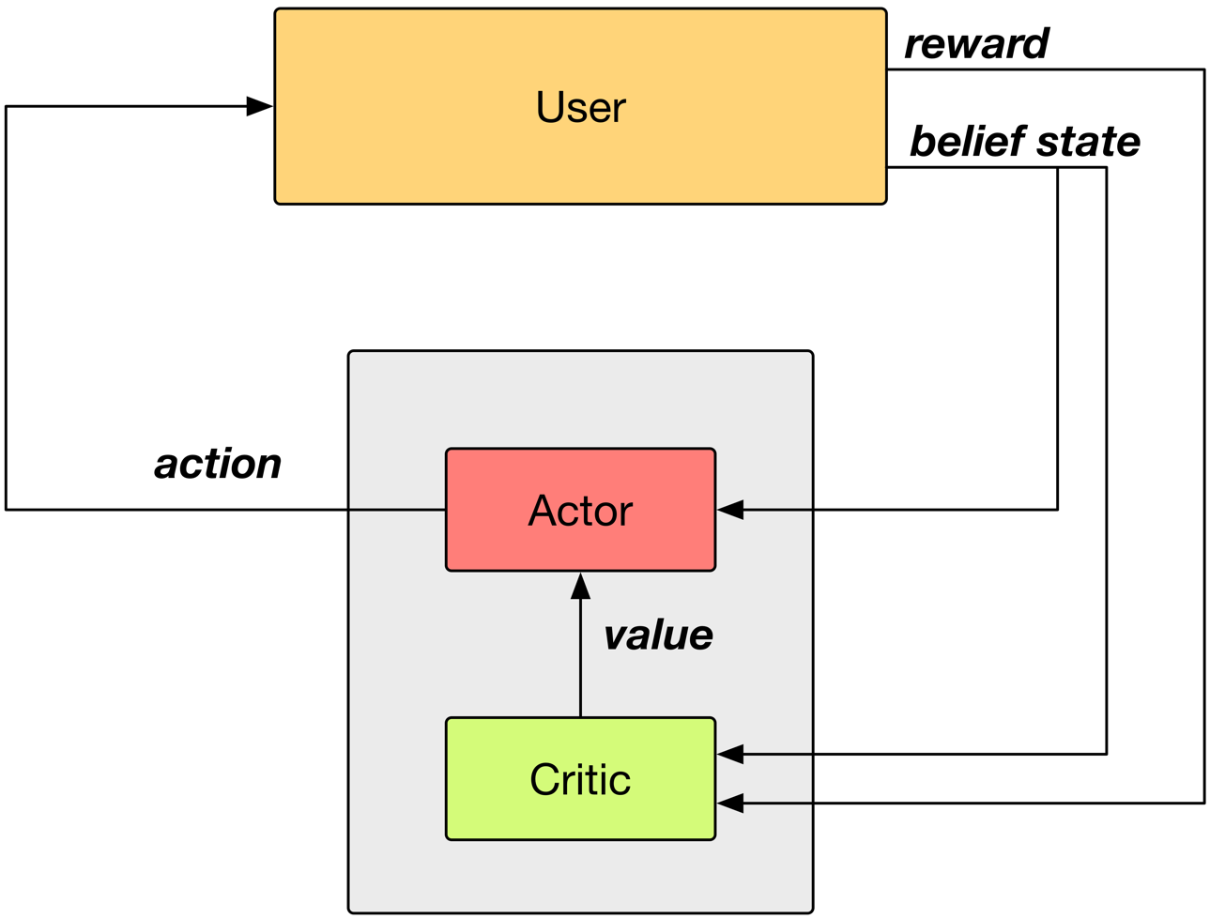
Actor-critic framework

Slide 22
Summary action space
Notes:
When the action space gets, whatever method you use will become computationally expensive. This is typically solved with a summary action space.
Two orders of magnitude actions!

Slide 23
Problem: Too many interactions are needed
Problem: learning slow, many interactions required (--> typically only 10 actions)
Solution: experience reply
Outcome: Ability to learn on two order of magnitude larger action spaces

Slide 24
Properties of ACER
Actor critic algorithm
Uses experience reply
Estimates Q-function off-policy
Uses Retrace algorithm to compute the targets
Uses trust-region policy optimisation

Slide 25
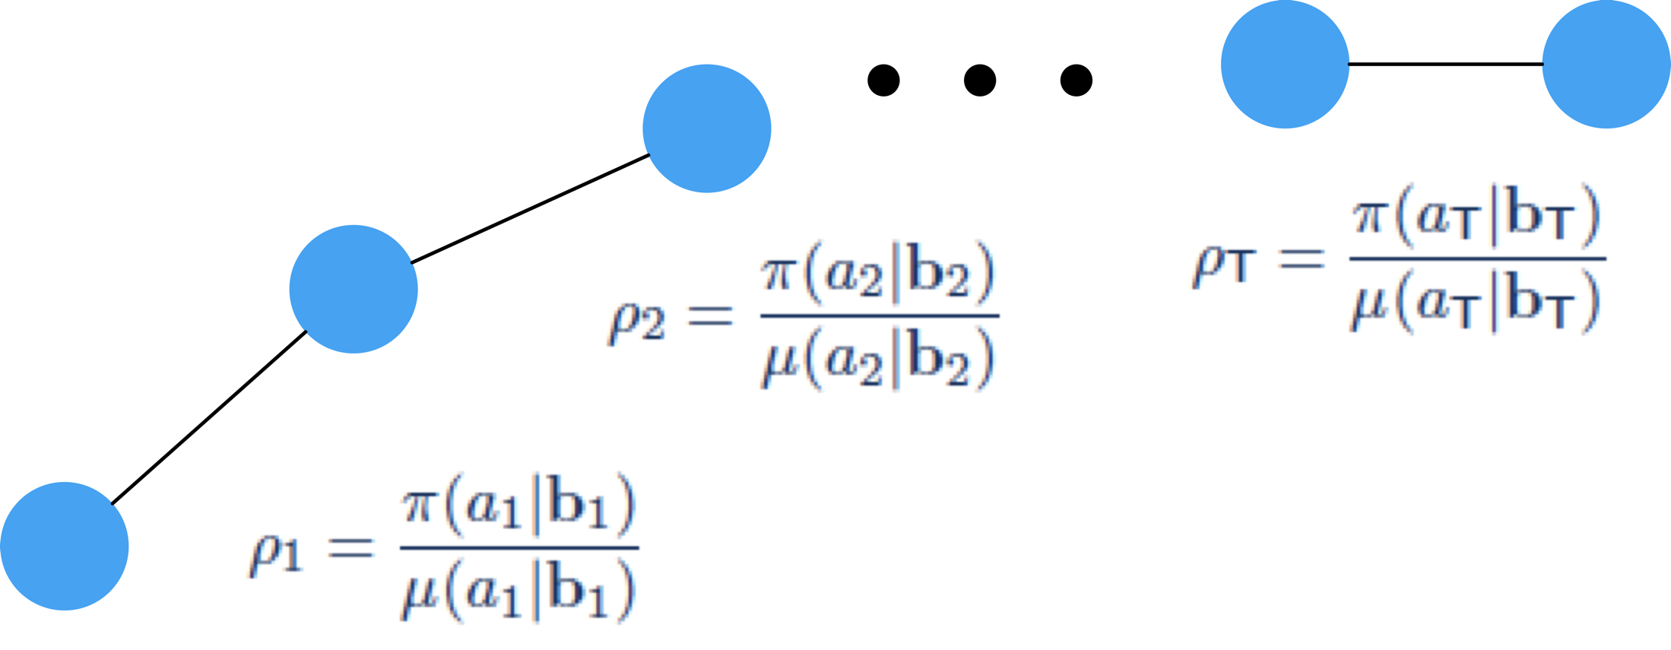
Experience replay
Off-policy learning follows a behaviour policy 𝛍 while optimising target policy 𝛑
This allows for the previous experience to be ‘replayed’
Correct the sampling bias with importance sampling ratio
ER Pool
Sample

Slide 26
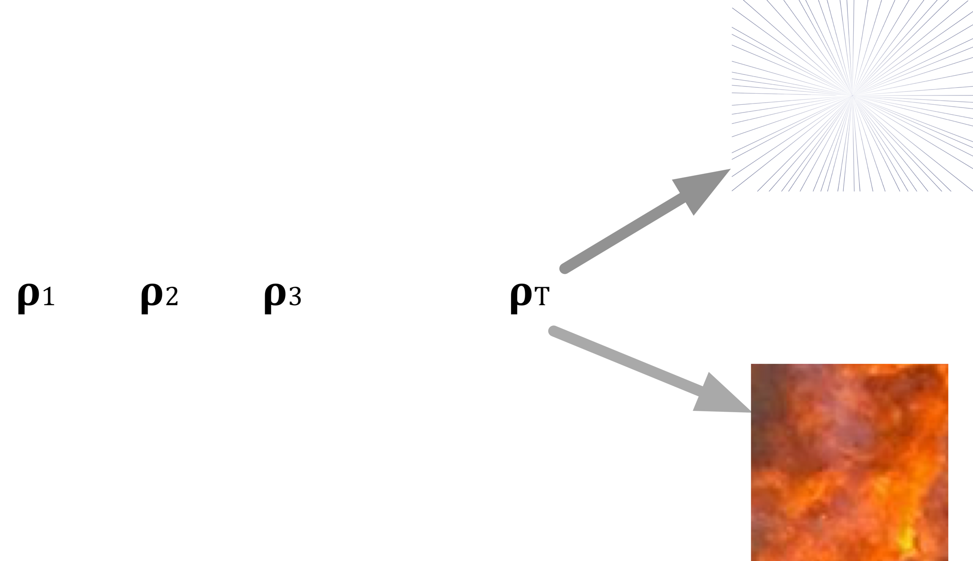
Truncated importance sampling
When we use importance weights for each sample in the trajectory we can easily obtain vanishing or exploding trajectories
This is why we need to truncate the importance sampling weights
We need to add a bias correction term to take into account that we are making an error

Slide 27
Q function targets
Modified loss
Targets are estimated via Retrace algorithm
non-biased estimates with small variance

Slide 28
Trust-region policy optimisation (TRPO)
Small changes in the parameter space can lead to erratic changes in the output policy.
Solution: natural gradient, but expensive to compute.
Distance metric in natural gradient can be approximated as the KL divergence.
TRPO approximates KL divergence using first order Taylor expansion and limits the KL divergence between policies of subsequent parameters.

Slide 29
Modified neural network architecture

Slide 30
Evaluation set-up
    Cambridge restaurant domain: 100 venues, 6 slots, 3 requestable
  Belief state input of size 268 (last system act, distribution over user intent …)
  15 summary actions (inform, request, confirm, …)
  1035 master actions
    User simulator operating on semantic level

Slide 31
Learning on master action space

Slide 32
Learning on master action space
Human evaluation (~450 dialogues per policy)
ACER | Summary space (15 actions) | Master space (1035 actions)
Success | 89.7% | 89.1%
Reward (20max) | 11.39 | 11.83
Turns | 6.42 | 5.98
Weisz, Budzianowski, Su, Gašić, Sample efficient deep reinforcement learning for dialogue systems with large action spaces, IEEE TASLP, 2018
Notes:
Equal if not better. Same success but quicker. But no longer hand-coded.

Slide 33
Problem 3: Limited user models
Problem: User models are limited, hand-crafted and typically do not operate on natural language
Solution: Train the user model in an end-to-end fashion
Outcome: More natural conversation

Slide 34
Neural user simulator
Goal generator generates a goal, which might change during the dialogue
Feature extractor provides a ‘value-independent’ embedding for the system’s response
Embedding is binary. Some indices indicate the system dialogue act, others if a mentioned value clashes with the goal
Sequence-to-sequence neural network, maps the feature history to the user utterance

Slide 35
Neural user simulator

Slide 36
Evaluation set-up
User simulator trained on DSTC2 data
Two policies (out of the 5) for each US used for training are tested with real users
First: Best performing policy when tested on the neural user simulator (NUS)
Second: Best performing policy when tested on the agenda-based simulator (ABUS)
Users were recruited through Amazon Mechanical Turk
250 test dialogues per policy

Slide 37
Results
Success rate
 |  | NUS | ABUS
 | NUS | 91.8% | 93.4%
 | ABUS | 90.0% | 88.5%
User simulator on which policy performs best
User simulator
for policy training

Slide 38
How to effectively evaluate dialogue models?
PyDial open source toolkit for building statistical dialogue systems
Common benchmark: set of environments and algorithms
Large goal oriented dialogue corpus MultiWOZ made open access
Google Faculty Award

Slide 39
PyDial: CUED open source Python toolkit
Implementations of statistical approaches for dialogue system modules
Easy configuration & extensibility
Domain-independent modules
Multi-domain conversational functionality
Get the code: pydial.org
Ultes, Rojas-Barahona, Su, Vandyke, Kim, Casanueva, Budzianowski, Mrkšić, Wen, Gašić, Young, PyDial: A Multi-domain Statistical Dialogue System Toolkit, ACL, 2017

Slide 40
Benchmarking policy optimisation
Fair comparison between different algorithms
Different domains, user simulator settings and noise levels in the input
18 environments in total
State of the art dialogue policy optimisation algorithms
Casanueva, Budzianowski, Su, Mrkšić, Wen, Ultes, Rojas-Barahona, Young, Gašić
A Benchmarking Environment for Reinforcement Learning Based Task Oriented Dialogue Management, NIPS Symposium on Deep RL, 2017

Slide 41
Conclusions
Machine learning allows us to
  share knowledge between belief tracking concepts
  learn among a large number of policy actions
  build more realistic models of users
Challenges ahead
  learnable knowledge base
  long-term interaction
  sentiment-awareness
Long term vision: natural conversation for goal-directed dialogues

