Slide 1
Fast and curious dialogue policy optimisation
Milica Gašić
Dialogue Group, Heinrich Heine University Düsseldorf

Slide 2

How to optimise interactive tasks?
Consider many possibilities of how to act/react
Explore sufficiently the possibilities
Always keep in mind the user

Slide 3
Essential components of dialogue

Slide 4
Reinforcement learning
observations o_{t}
Dialogue system
reward r_{t}
belief states b_{t}
action a_{t}
Notes:
- Example of rewards

Slide 5
Reinforcement learning
observations o_{t}
Dialogue system
reward r_{t}
belief states b_{t}
action a_{t}
Long term user satisfaction
Policy
Notes:
Explain that Q is long term user satisfaction

Slide 6
Reinforcement learning
Return
Value function
Q-function

Slide 7
Deep Reinforcement Learning
Value function, Q-function or policy approximated via a neural network
(+) approximation by non-linear functions
(as preferred in reinforcement learning)
(-) optimisation algorithms find only local optima.

Slide 8
Deep Q-network (DQN) algorithm
Q-function is approximated as a deep neural network, the gradient is
(-) a biased estimate
(-) states are correlated
(-) targets are non-stationary

Slide 9
Policy approximation as a neural network
Policy is parameterised
The objective function is the value of the initial state
Policy gradient theorem
Directly used in REINFORCE, but also in actor-critic methods

Slide 10
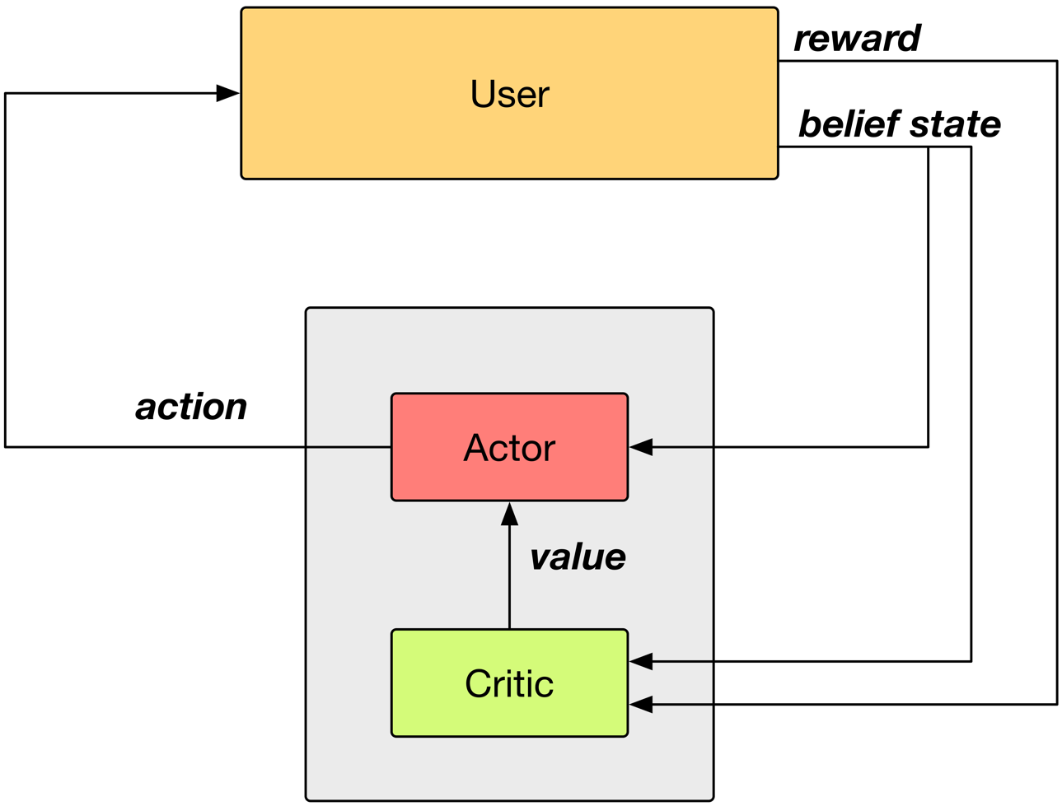
Actor-critic framework

Slide 11
Summary action space
Notes:
When the action space gets, whatever method you use will become computationally expensive. This is typically solved with a summary action space.
Two orders of magnitude actions!

Slide 12
1. Problem: Too many interactions are needed
Problem: learning slow, many interactions required (--> typically only 10 actions)
Solution: experience reply
Outcome: Ability to learn on two order of magnitude larger action spaces

Slide 13
Properties of ACER
Actor critic algorithm
Uses experience reply
Estimates Q-function off-policy
Uses Retrace algorithm to compute the targets
Uses trust-region policy optimisation
𝜺-greedy learning

Slide 14
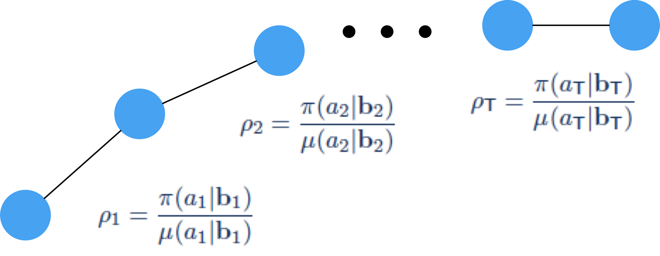
Experience replay
Off-policy learning follows a behaviour policy 𝛍 while optimising target policy 𝛑
This allows for the previous experience to be ‘replayed’
Correct the sampling bias with importance sampling ratio
ER Pool
Sample

Slide 15
Q function targets
Modified loss
Targets are estimated via Retrace algorithm
non-biased estimates with small variance

Slide 16
Modified neural network architecture

Slide 17
Evaluation set-up
    Pydial open source dialogue toolkit pydial.org
    Cambridge restaurant domain: 100 venues, 6 slots, 3 requestable
  Belief state input of size 268 (last system act, distribution over user intent …)
  15 summary actions (inform, request, confirm, …)
  1035 master actions
    User simulator operating on semantic level

Slide 18
Learning on master action space

Slide 19
Learning on master action space
Human evaluation (~450 dialogues per policy)
ACER | Summary space (15 actions) | Master space (1035 actions)
Success | 89.7% | 89.1%
Reward (20max) | 11.39 | 11.83
Turns | 6.42 | 5.98
Weisz, Budzianowski, Su, Gašić, Sample efficient deep reinforcement learning for dialogue systems with large action spaces, IEEE TASLP, 2018
Notes:
Equal if not better. Same success but quicker. But no longer hand-coded.

Slide 20

2. Problem: Standard RL algorithms make random moves
Exploitation?
Exploration?

Slide 21
Intrinsic reward
Intrinsic rewards provide additional rewards estimated by the system
They can be used in combination with external – extrinsic reward
Simple model of curiosity:
If an action that we take leads us to a belief state that we could not predict it would take us there, we are being curious.

Slide 22
Intrinsic curiosity model [Pathek et al, 2017]
  Inverse model – estimate the feature mapping which finds the most useful features of two subsequent belief states for action prediction
  Forward model – estimate the next belief state given the feature encoding of the current belief state and the action taken
  Intrinsic reward – the difference between the estimated belief state and true belief state

Slide 23
Intrinsic curiosity model

Slide 24
Experimental set-up
Pydial open source dialogue toolkit pydial.org
Cambridge restaurant information system (6 slots, 200 entities)
Belief state 268 dimensions
15 summary actions (request, inform…)
Simulated user with 15% semantic error rate

Slide 25
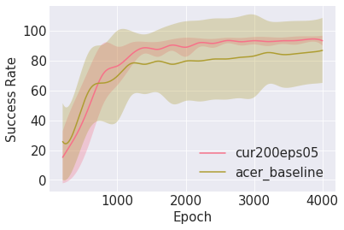
Curiosity results
Wesselman, Wu, Gašić, Curiosity driven reinforcement learning for dialogue management, ICASSP, 2019

Slide 26
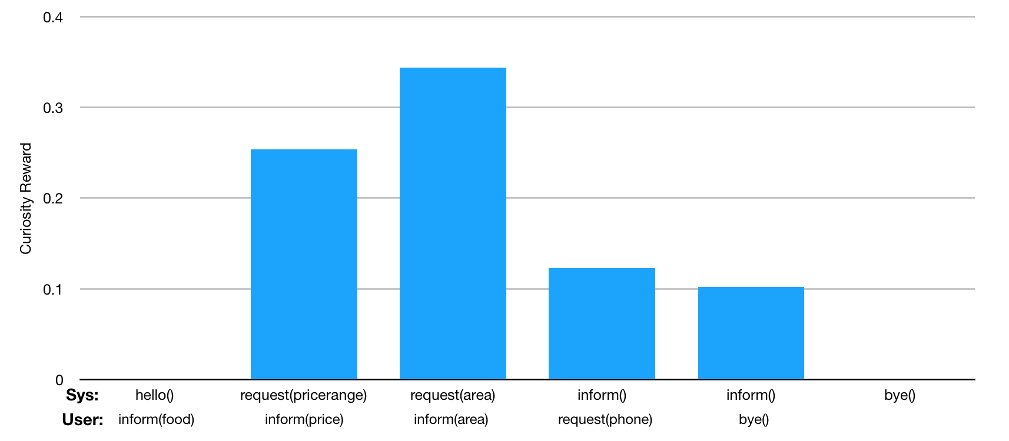
Example dialogue

Slide 27
Conclusions
Deep RL is a promising approach to optimise dialogue behaviour
It allows substantially increasing the number of learned actions
It also supports incorporating models of curiosity to more quickly achieve better performance
These properties are essential for modelling a large majority of complex interaction tasks

